Slide 1


By:
Hashem Bajabaa
Abdelaziz Alameri

Slide 2
INTRODUCTION

Slide 3
02
Why This Market

Slide 4
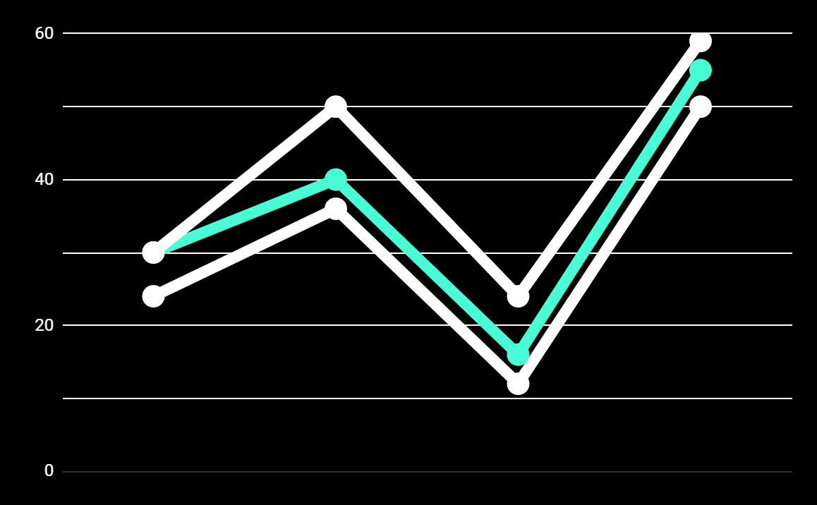
Car Wash Analysis
Market Size Per Year
+3 Billons
+10%
Growth Per Year

Slide 5
03
Problems

Slide 6
Merchant Problems
01
Tracking Issues
02
Lack of Business Performance
03
Customer Satisfaction
04
Data About Customer

Slide 7
Customer Problems
01
Lack of information
02
Loyalty Program
03
Rating And Review

Slide 8
04
Solutions

Slide 9
Solutions
Marketplace
Loyalty Program
Tracking System

Slide 10
05
Tools

Slide 11


Tools
Java and Spring Boot
Figma
Data Grip&IntelliJ
Post Man

Slide 12
PROJECT STAGES
Stage 3
Stage 2
UI Design
Stage 1
Budling Backend
Database Design

Slide 13

Demo
06

Slide 14
07
Future Work

Slide 15

PostMan

